Slide 1
Spatial Regression
Mark Green
DASC507 – Advanced Biostatistics II
Analysis Methods for Complex Data Structures

Slide 2
Outline
Linear regression – a recap
Spatial regression
Spatial lag
Spatial error
Approaches that combine both
Criticisms
Case study

Slide 3
Linear regression – a recap
Why do we use regression?
To try and explain the world (note: correlation ≠ causation)
To predict an outcome of interest

Slide 4

Linear regression – a recap
Outcome of interest
Coefficient applied to X
$$y=α+βX+ⅇ$$
Constant
Explanatory variables
Error term

Slide 5
Linear regression – a recap
Assumptions of the approach
Relationships are linear
Explanatory variables are not multicollinear
Errors are normally distributed
Homoscedasticity of errors
Independence of errors…
Where we have spatial data, independence of errors may be violated…

Slide 6
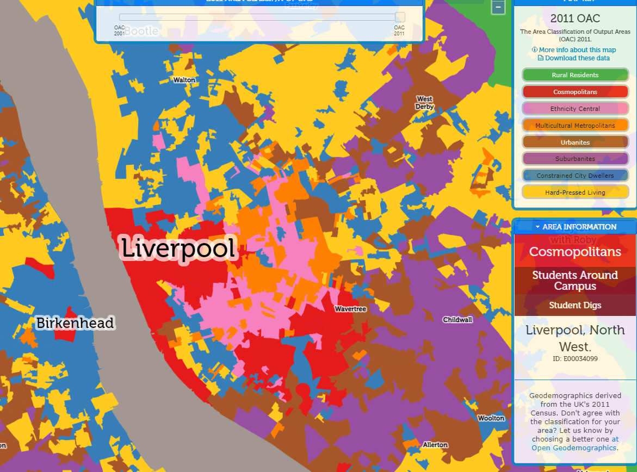
Linear regression – a recap
Tobler’s first law of geography “everything is related to everything else, but near things are more related than distant things”
“Birds of a feather, flock together”
If areas closer together are similar in characteristics, then we no-longer have independence of observations (and likely error terms)
May reflect unobserved (or not measured) factors
Output Area Classification via maps.cdrc.ac.uk

Slide 7
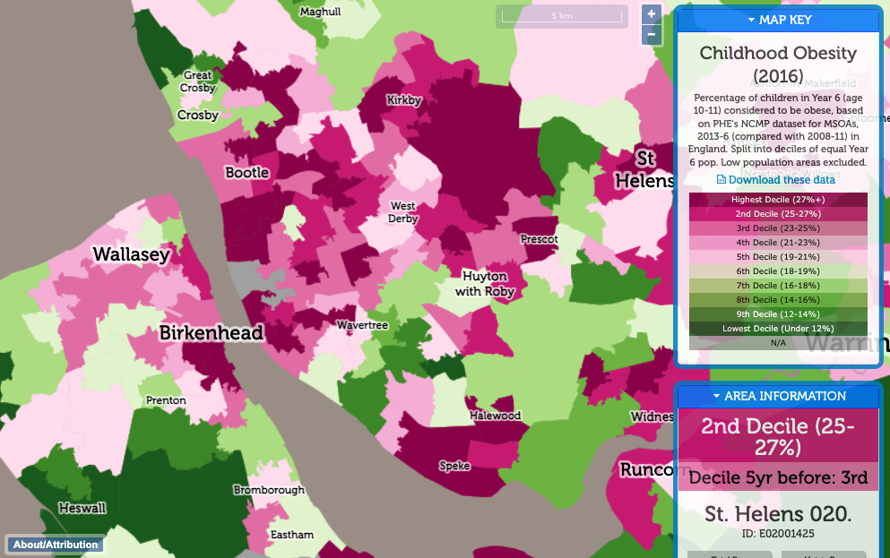
Linear regression – a recap
Applies to health outcomes where spatial patterns are not random
Childhood obesity via maps.cdrc.ac.uk

Slide 8
Spatial regression
There are a lot of regression approaches that account for space, today we will focus on
Spatial lag regression approaches
Spatially Lagged X-variables model
Spatial AutoRegressive model
Spatial error regression approaches
Spatial Error Model
Approaches that combine both spatial lag and spatial error models
Spatial Durbin Error

Slide 9
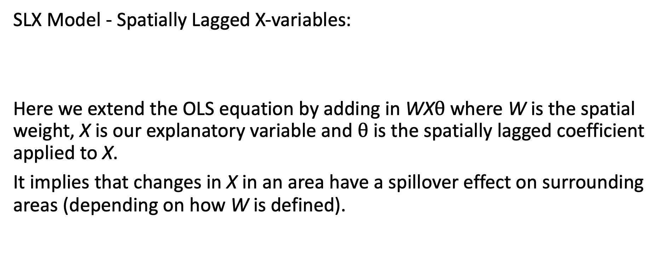
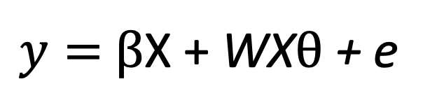
Spatial regression – spatial lag
SLX Model - Spatially Lagged X-variables:
Here we extend the OLS equation by adding in WX$θ$where W is the spatial weight, X is our explanatory variable and $θ$ is the spatially lagged coefficient applied to X.
It implies that changes in X in an area have a spillover effect on surrounding areas (depending on how W is defined).
$y=$ $β$X + WX$θ$ + e

Slide 10
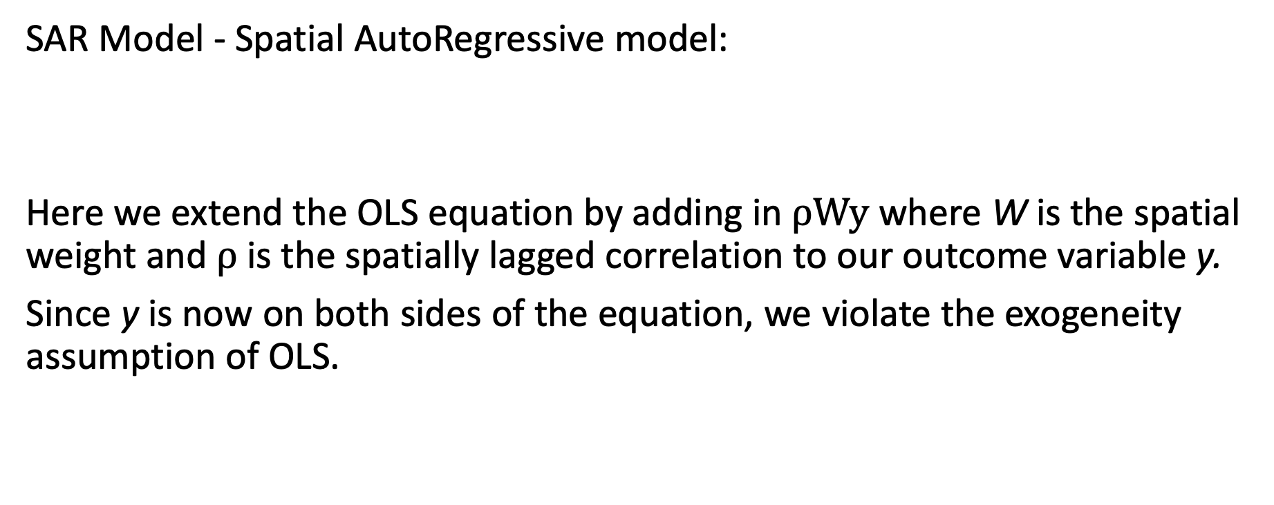
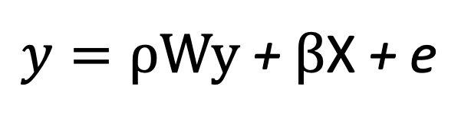
Spatial regression – spatial lag
SAR Model - Spatial AutoRegressive model:
Here we extend the OLS equation by adding in $ρ\text{Wy}$where W is the spatial weight and$ρ$ is the spatially lagged correlation to our outcome variable y.
Since y is now on both sides of the equation, we violate the exogeneity assumption of OLS.
$y=ρ\text{Wy} \text{+} β$X + e

Slide 11
Spatial regression – spatial lag
Interpreting spatially lagged coefficients requires caution
Direct effects – the immediate association (or effect) of an explanatory variable on an outcome
Indirect effects represent how variables in surrounding areas influence an outcome
Direct effect + indirect effect = total effect -> need to consider both effects to get the full picture of how processes act
To get standard errors and p-values, need to use simulations rather than estimate directly (unlike SLX model)

Slide 12
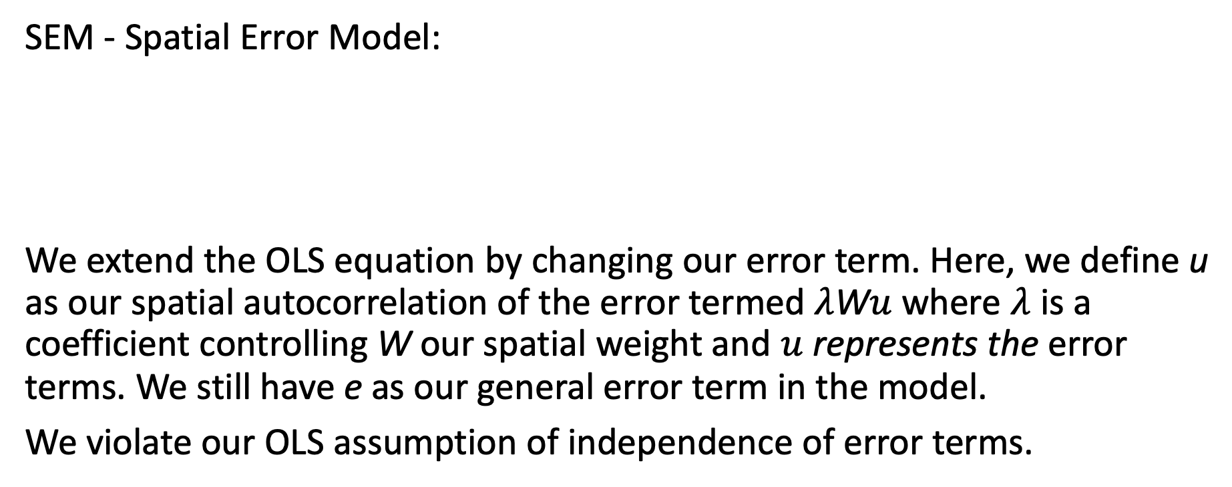
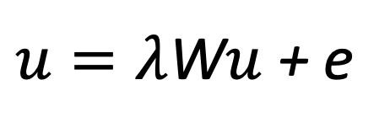
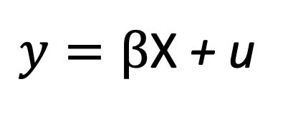
Spatial regression – spatial error
SEM - Spatial Error Model:
We extend the OLS equation by changing our error term. Here, we define u as our spatial autocorrelation of the error termed $λ$W$u$ where $λ$ is a coefficient controlling W our spatial weight and $u$ represents the error terms. We still have e as our general error term in the model.
We violate our OLS assumption of independence of error terms.
$y=β$X + u
$u=λ$W$u$ + e

Slide 13
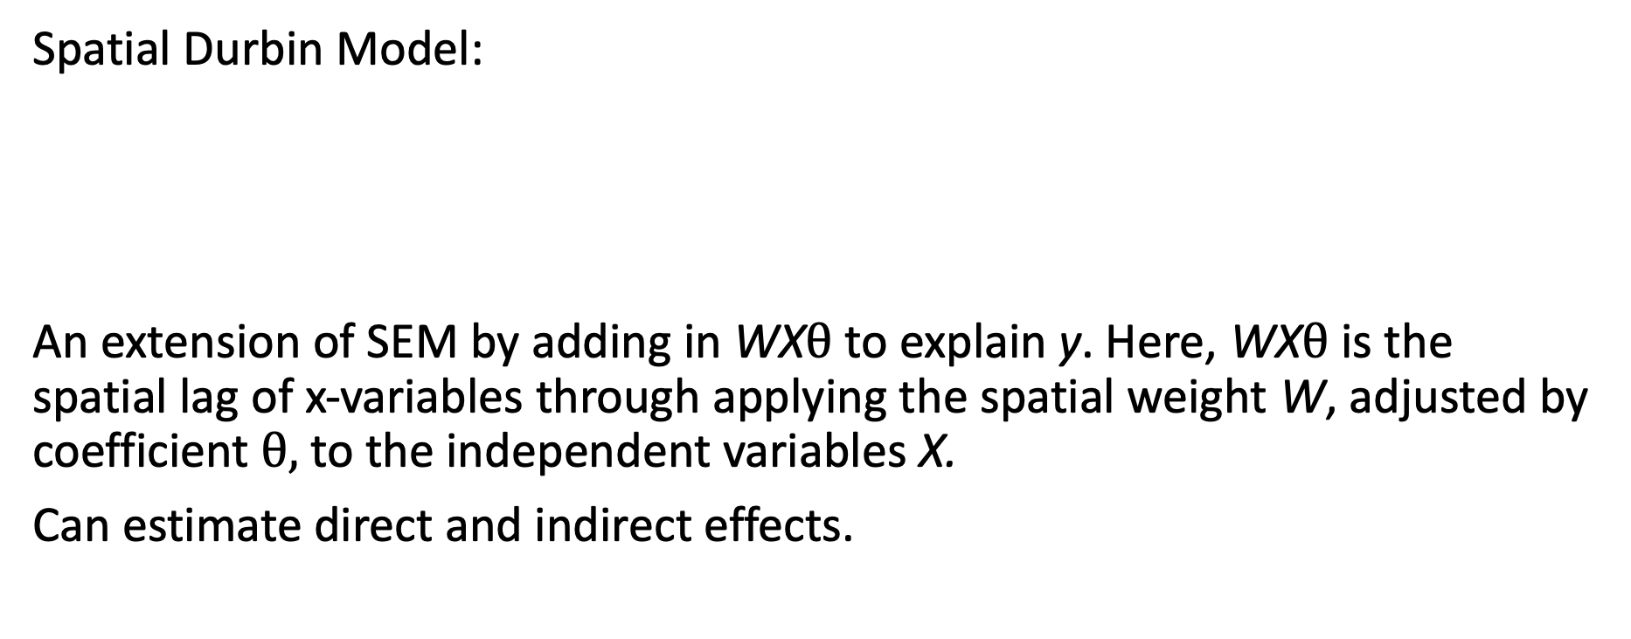
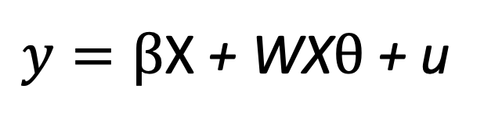
Spatial regression – spatial lag and error
Spatial Durbin Model:
An extension of SEM by adding in WX$θ$ to explain y. Here, WX$θ$ is the spatial lag of x-variables through applying the spatial weight W, adjusted by coefficient $θ,$to the independent variables X.
Can estimate direct and indirect effects.
$y=β$X + WX$θ$+ u
$u=λ$W$u$ + e

Slide 14
Spatial regression
How do you select a model?
Model fit statistics
Test for spatial dependence in data and nature of this (always check for clustering of model residuals)
Hausman test
Conceptual reasons for spatial effects (e.g., lagged or spillover effects)

Slide 15
Criticisms
All models are for linear regression, binary/count models harder to estimate using generalized versions of these approaches (Bayesian approaches more helpful here)
Be careful in interpreting spillover effects – association based

Slide 16
Case study
Dearden et al. 2020. Exploring the histories of health and deprivation in Britain, 1971–2011. Health & Place 61: 102255. https://doi.org/10.1016/j.healthplace.2019.102255
Large geographical inequalities in health across Great Britain
Neighourhood deprivation is a fundamental cause of inequalities
Ecological analyses can help profile the changing nature of inequalities, including who and where is affected
Uses Census data (Great Britain) converted to 1x1km² grids
Outcome variable is self-reported Limiting Long-Term Illness (%)

Slide 17
Case study
 | 1991 |  | 2001 |  | 2011
 | OLS | SLQC | OLS | SLQC | OLS | SLQC
Regression Coefficients
Constant | 9.83* | 2.58* | 15.74* | 3.28* | 15.78* | 3.22*
Townsend Score | 0.57* | 0.30* | 0.77* | 0.39* | 0.88* | 0.47*
Aged 65 and over | 0.25* | 0.13* | 0.45* | 0.27* | 0.43* | 0.27*
Aged 0-14 | −0.11* | −0.07* | −0.18* | −0.08* | −0.18* | −0.08*
Not UK Born | −1.57* | −0.46* | −2.44* | 0.83* | −2.77* | −1.00*
Not White | 0.68* | 0.02* | 0.54* | 0.13* | 0.25* | 0.05*
ρ |  | 0.73* |  | 0.69* |  | 0.66*
Model Fit
R2 | 0.45 | 0.78 | 0.52 | 0.80 | 0.55 | 0.77
AIC | 617,187 | 519,471 | 698,151 | 605,212 | 685,644 | 603,440
log-likelihood | −308,588 | −259,728 | −349,070 | −302,599 | −342,816 | −301,713
Significant spatial patterns observed and attenuate the associations for coefficients observed in the OLS model

Slide 18
Case study
Comparing model residuals shows how the spatial model helps to account for the unexplained patterns in the OLS model

Slide 19
Further reading
Anselin L. 2005. Under the hood issues in the specification and interpretation of spatial regression models. Agricultural Economics 27(3): 247-267. https://doi.org/10.1111/j.1574-0862.2002.tb00120.x
Anselin L. 2008. Spatial Regression. pp 255-275. In Fotheringham and Rogerson (Eds.) The SAGE Handbook of Spatial Analysis. SAGE: London.
Arbia G. 2014. A Primer for Spatial Econometrics. Palgrave: London.
Rey S, et al. 2021. Spatial Regression. In Geographic Data Science with Python. https://geographicdata.science/book/notebooks/11_regression.html

